Slide 1
Workshop on Affective Haptics
Emotion Augmentation through Affective Haptics and Visual Stimuli
Dzmitry Tsetserukou
Alena Neviarouskaya

Slide 2
Introduction
Communication is a process of transferring information (e.g., facts, thoughts, opinions, emotions) from one person to another.
Channels of face-to-face communication:
Verbal:
spoken words
prosodic features (intonation, stress, pitch, loudness, etc.)
Nonverbal:
gaze and eye movements
facial expressions
tints of facial skin
gestures
body postures
touch
“Emotion is what gives communication life. A conversation between emotionally involved partners is bright and lively, but a meeting without feeling is deadly dull.”
Sally Planalp, 1999

Slide 3
Problem statement
Computer-mediated communication occur via computer-mediated formats , such as e-mail, Instant Messenger, chat room, online 3D virtual world.
With respect to emotional communication, conventional mediated systems usually
support only simple textual cues like emoticons or abbreviations
lack visual emotional signals such as facial expressions and gestures
support only manual control of expressiveness of graphical representations of users (avatars)
completely miss such important channel of social communication as sense of touch
Yahoo! IM
Second Life

Slide 4
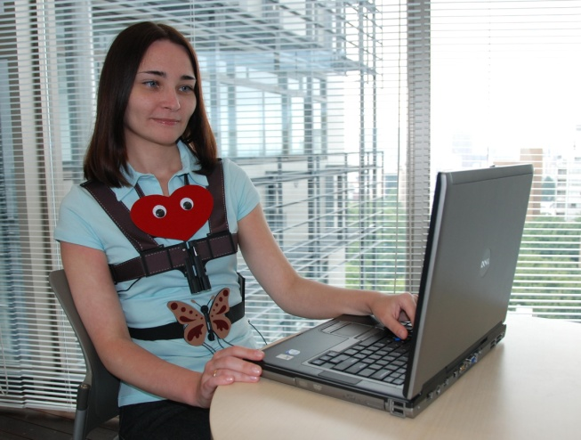
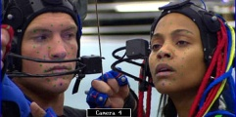
iFeel_IM!: communication system with emotion enchancing garment
The philosophy behind iFeel_IM! (intelligent system for Feeling enhancement powered by affect sensitive Instant Messenger) is
“I feel [therefore] I am!”
Emotional Telepresence, technology that lets users feel emotionally as if they were present and communicating at a remote physical location.

Slide 5
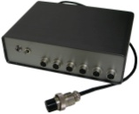
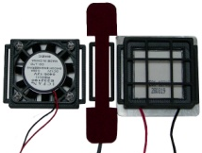
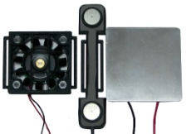
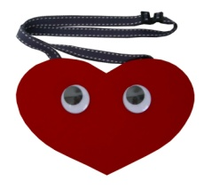
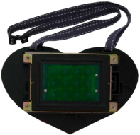
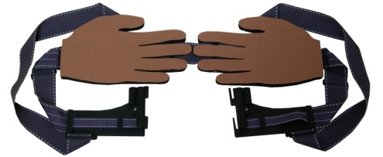
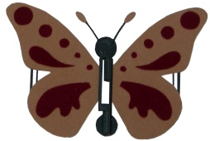
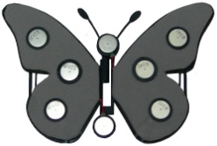
Architecture of iFeel_IM!
Web-based interface of Affect Analysis Model
3D world Second Life
chat text
emotion: intensity
PC of each user
Chat log file
Haptic Devices Controller
D/A
Driver box
HaptiTemper and HaptiShiver
HaptiHeart HaptiHug HaptiTickler HaptiBatterfly

Slide 6
Affect Analysis Model: recognition of emotions from text
Sentence
III stage
I stage
Affect database
Symbolic cue analysis module
Word-level analysis module
Test for emoticons, abbreviations, acronyms, interjections, “?” and “!” marks, repeated punctuation and capital letters
II stage
IV stage
Syntactical structure analysis module
Phrase-level analysis module
Emoticon or em abbr.
“yes” “no”
Estimation of resulting emotion state
Sentence pre-processing for parser
Stanford Parser
V stage
output of the parser
Sentence-level analysis module
Parser output processing
Sentence annotated by emotion
emotion category: intensity emotion category: intensity
Emotions: Anger, Disgust, Fear, Guilt, Interest, Joy, Sadness, Shame, Surprise

Slide 7
Evaluation of the Affect Analysis Model
Experimental dataset: 700 sentences from Weblog Data Collection
3 human annotators
Gold standard | Measure | Fine-grained categories
 |  | Neutral | Anger | Disgust | Fear | Guilt | Interest | Joy | Sadness | Shame | Surprise
AAM with Stanford Parser
2-3 annotators agreed (656 sentences) | Accuracy | 0.649
 | Precision | 0.30 | 0.77 | 0.64 | 0.74 | 0.71 | 0.61 | 0.83 | 0.74 | 0.50 | 0.76
 | Recall | 0.55 | 0.34 | 0.70 | 0.80 | 0.55 | 0.81 | 0.71 | 0.64 | 0.67 | 0.72
3 annotators agreed (249 sentences) | Accuracy | 0.751
 | Precision | 0.15 | 0.92 | 0.83 | 0.87 | 0.80 | 0.50 | 0.96 | 0.88 | 0.50 | 0.82
 | Recall | 0.75 | 0.65 | 0.56 | 0.83 | 0.67 | 0.75 | 0.78 | 0.74 | 0.33 | 0.82
AAM with Connexor Machinese Syntax
2-3 annotators agreed (656 sentences) | Accuracy | 0.726
 | Precision | 0.46 | 0.83 | 0.63 | 0.76 | 0.75 | 0.56 | 0.87 | 0.78 | 0.57 | 0.85
 | Recall | 0.55 | 0.41 | 0.73 | 0.84 | 0.68 | 0.88 | 0.83 | 0.72 | 0.89 | 0.77
3 annotators agreed (249 sentences) | Accuracy | 0.815
 | Precision | 0.26 | 0.92 | 0.83 | 0.91 | 0.83 | 0.44 | 0.95 | 0.88 | 0.67 | 0.86
 | Recall | 0.75 | 0.65 | 0.56 | 0.88 | 0.83 | 0.88 | 0.88 | 0.79 | 0.67 | 0.82

Slide 8
EmoHeart
Joy Sadness
Percentage distribution of sentences
Anger Fear

Slide 9
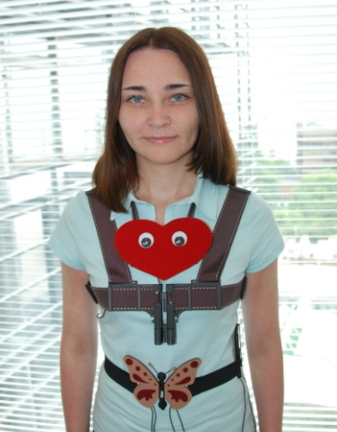
Affective haptic devices activated in iFeel_IM!
Front side
Back side
HaptiHeart
HaptiHug
We selected four distinct emotions: ‘Anger’, ‘Fear’, ‘Sadness’, ‘Joy’.
Emotion elicitation implicitly (HaptiHeart, HaptiButterfly, HaptiTemper, and HaptiShiver).
Evoking affect in a direct way (HaptiTickler).
Sense of social touch (HaptiHug) for influencing on the mood and providing some sense of physical co-presence.
Hapti
Shiver
HaptiButterfly
HaptiTickler
HaptiTemper
Affective haptic devices worn on a human body

Slide 10
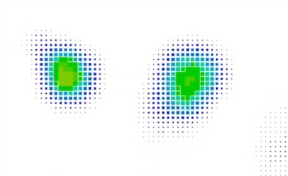
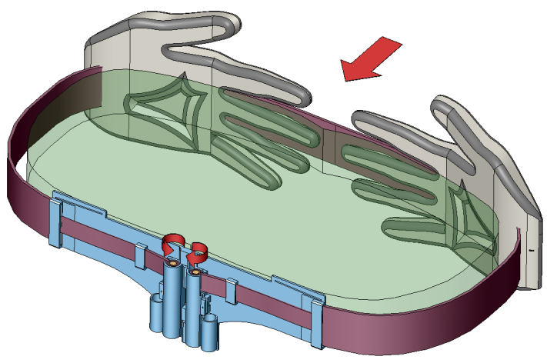
HaptiHug: the way of realistic hugging over distance
In a real world, whenever one person interacts with another, both observe, perceive and interpret each other’s emotional expressions communicated through a variety of signals.
Among many forms of physical contact, hug is the most emotionally charged one. It conveys warmth, love, and affiliation.
Real life hugging Second life hugging HaptiHug
Soft Hand
Direction of belt tension
Pressure
Soft Hand
Pressure distribution
Human body
Motor holder
Parameters | Plain Hug
Pressure on male back side, [kN/m²] | 1.4
Pressure on chest, [kN/m²] | 2.3
Average duration, [sec] | 1.98
Pressure
Couple of motors
Pressure
Direction of belt tension
HaptiHug

Slide 11
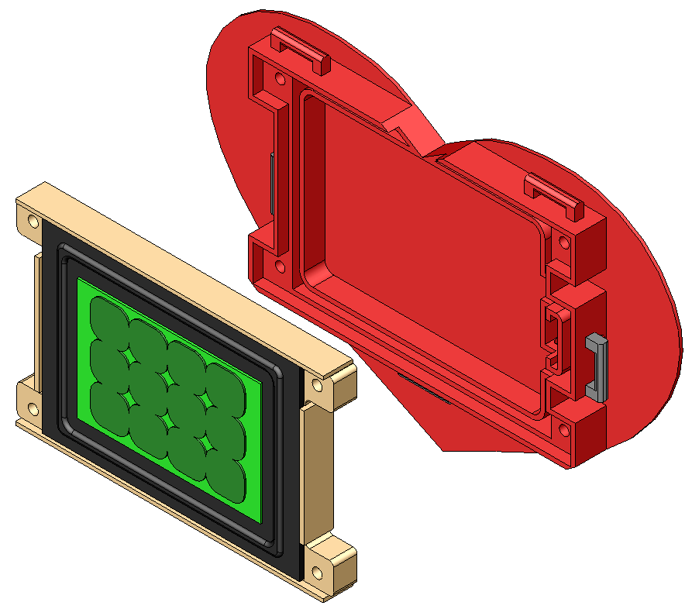
HaptiHeart enchancing our emotions
Of the bodily organs, the heart plays a particularly important role in our emotional experience.
We developed heart imitator HaptiHeart to produce special heartbeat patterns according to emotion to be conveyed or elicited.
The pre-recorded sound signal with low frequency generates the pressure on the human chest through vibration of the speaker surface.
Heart-shaped Speaker Case
Flat Speaker
HaptiHeart

Slide 12
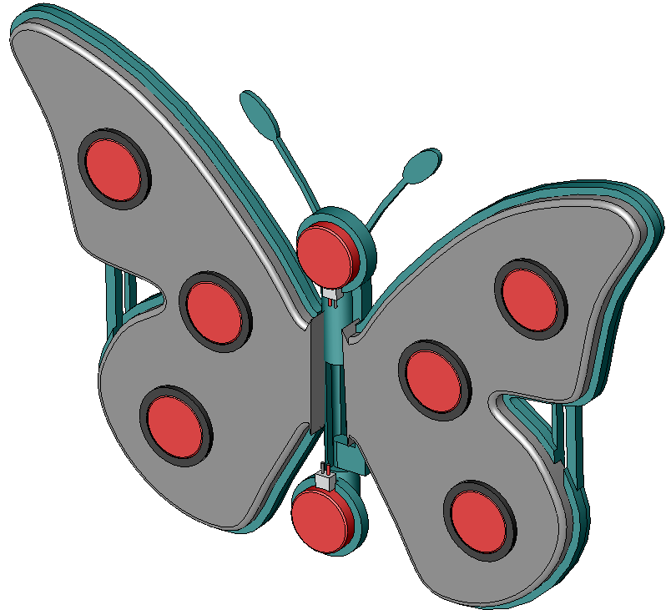
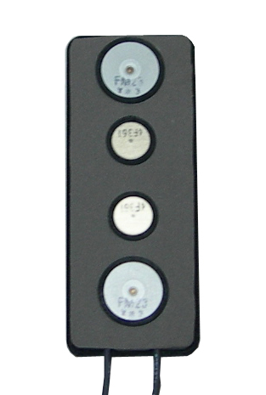
HaptiButterfly and HaptiTickler : devices for positive emotions
Plastic frame
The idea behind HaptiButterfly device is to reproduce effect of “Butterflies in the stomach” (fluttery or tickling feeling in the stomach felt by people experiencing love) by means of the arrays of vibration motors attached to the abdomen area of a person.
We developed HaptiTickler with the purpose to evoke positive affect (joy emotion) in a direct way by tickling the ribs of the user.
Revolute joint
Vibration motor
Holder
HaptiButterfly
Large vibration motor (index finger)
Small vibration motors (middle and ring finger)
Large vibration motor (little finger)
Video
HaptiTickler

Slide 13
User Study
Haptic device | Emotions |  |  |  | Social Touch
 | Joy | Sadness | Anger | Fear
HaptiHeart |  | 83.3% | 66.7% | 100%
HaptiButterfly | 83.3%
HaptiTickler | 100%
HaptiHug | 100% |  |  |  | 100%
The results of the user study revealed that the devices generated the corresponding emotion successfully.

Slide 14
Social pseudo-touch (animation) increases the perception:
Perception of hugging force
Perception of heartbeat
Tickling

Slide 15
Haptinoid: bilateral tactile interaction with avatar through haptic gestures
Objectives and novelty:
Portable communication system with wearable affective haptic devices driven by user’s finger gestures applied to avatar.
Novel tactile language (haptish) for avatar-mediated communication.
Implementation:
Four basic tactile gestures control wearable devices (HaptiHug, HaptiHeart, HaptiTickler, HaptiShiver) and sensors (microphone, skin conductivity)
Hug (Pinch)
Heartbeat
(Double Tap)
Tickling
(Flicking)
Frightening
(Continuous tap)

Slide 16
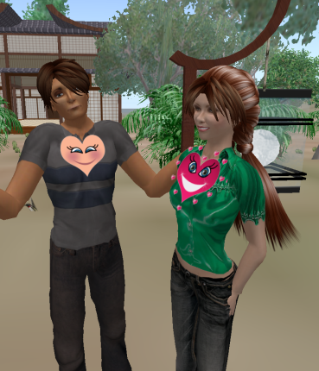
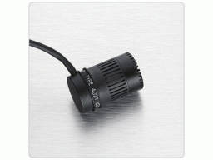
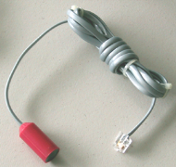
BodyTwitter: feel and see your friend’s heartbeat
HaptiHeart with sensors
Touch panel
Microphone with preamplifier
Temperature sensor
HaptiHeart
The purpose of the BodyTwitter is to engage people into communication by transmitting their heartbeats, body temperature online. So that friends can feel their physical presence while being apart.

Slide 17
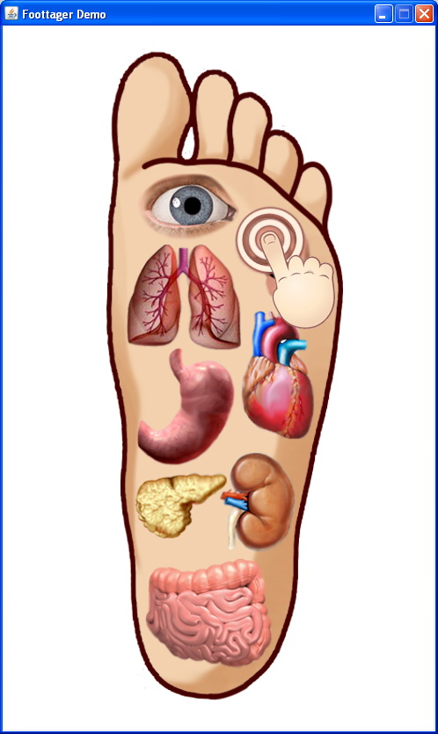
Foottager: touch panel mediated footprint massager
Objectives and novelty:
Making user-to-user reflexology foot massage remotely through touch panel.
Enhancing not only health condition, but also social connection between people by means of remote massage.
Implementation:
Slipper-shaped massager with the DC servo and vibration motors to produce the haptic stimuli on the user’s foot.
Touchable application with image of partner’s footprint.

Slide 18
Thank you!

